Slide 1
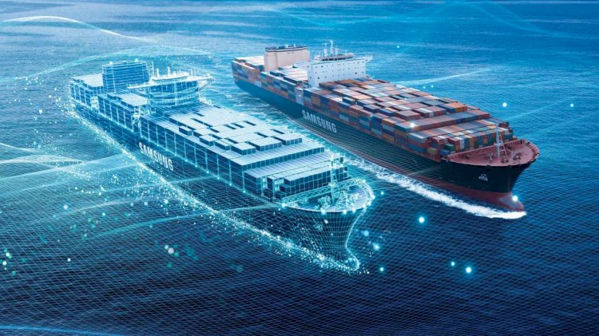

Slide 2



Ship As A Digital Enterprise

Slide 3





AlphaOri Product Offerings
IOT / Big Data Platform and applications
Hardware & Software installation
Technical, Commercial and operator basis
Software only app for commercial operations
Maximises the TCE $$ as well as saves bunker when required
ERP Software for ship management
Built on Future Proof Microsoft BC Platform
Notes:
SV - Light wt no hardware, manual data feed once a day, commercial team audience : POC can be done
Smartship - Hardware based, real time data, deeper insights and control, Commercial team + Ops team
optimization program
Noon report based data input
Commercial team focus
Voyage/Vessel optimization applications
To aid Ship management & operations
Technical/Ship Operators
PMS, Purchase, QMS, DMS

Slide 4
3 Key AUTOMATED REAL TIME Value Adds
A
Live Mobile App
Live CP Dashboard
Live Hull Performance
REAL TIME PERFORMANCE MONITORING
B
Fuel Optimization
Predictive Maintenance
REAL TIME PERFORMANCE ENHANCEMENT
C
Real Time Notifications and Advisory
Safety and Reliability
Compliance
REAL TIME ALERTS AND DECISION SUPPORT
Notes:
1

Slide 5
3 Key REAL TIME Value Adds
A
Live Mobile App
Live CP Dashboard
Live Hull Performance
REAL TIME PERFORMANCE MONITORING
B
Fuel Optimization
Predictive Maintenance
REAL TIME PERFORMANCE ENHANCEMENT
C
Real Time Notifications and Advisory
Safety and Reliability
Compliance
REAL TIME ALERTS AND DECISION SUPPORT
Notes:
1

Slide 6

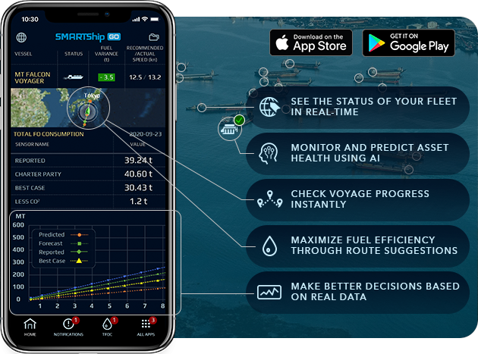



FOR BOTH ANDROID AND IOS
Follow the below instructions
iOS:
https://testflight.apple.com/join/31UbonHF
Android: https://play.google.com/apps/testing/sg.alphaori.smartshipgodemo
LOGIN CREDENTIALS
Username: customer_demo
Password:
Notes:
5

Slide 7
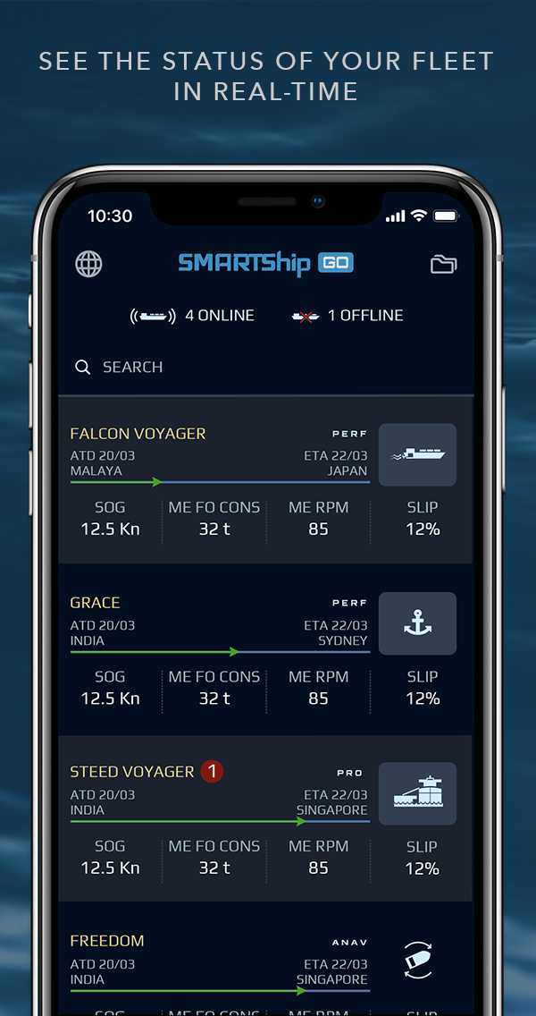
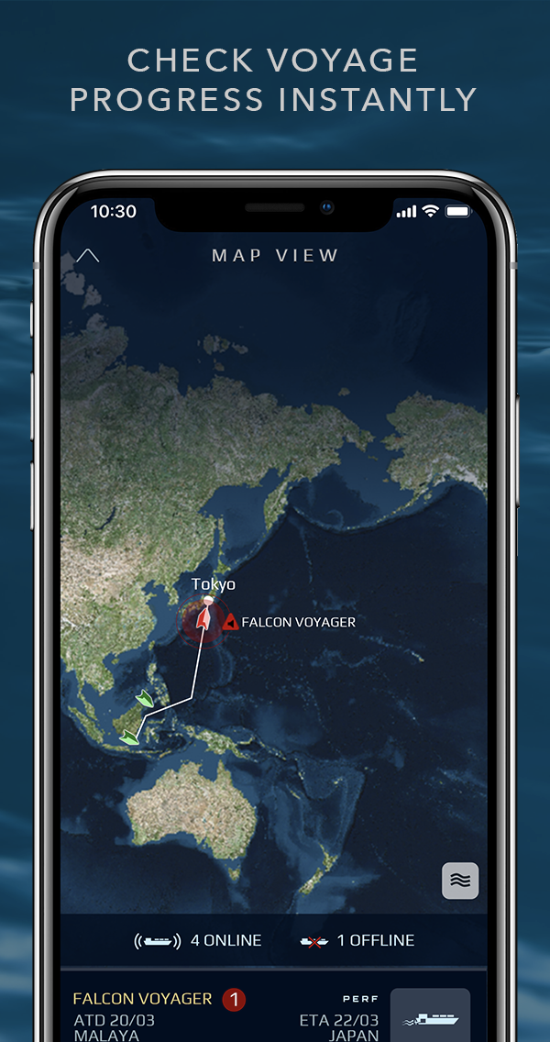
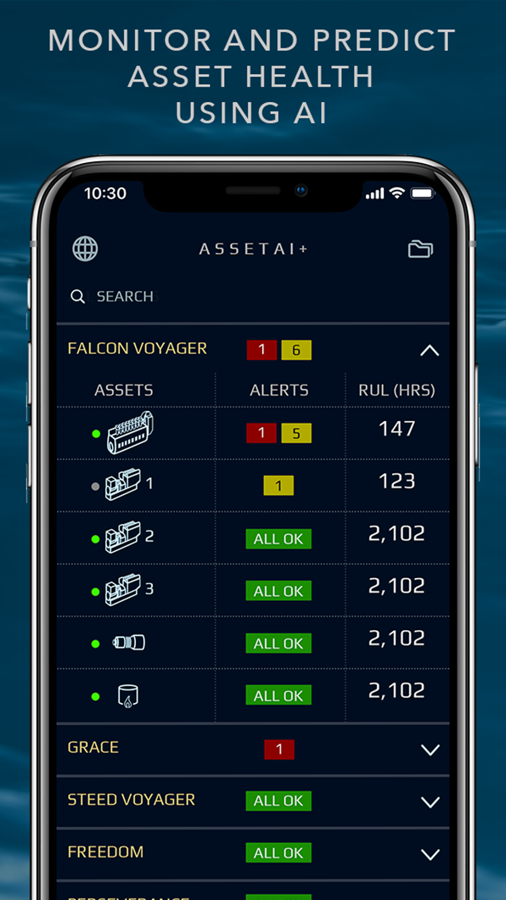
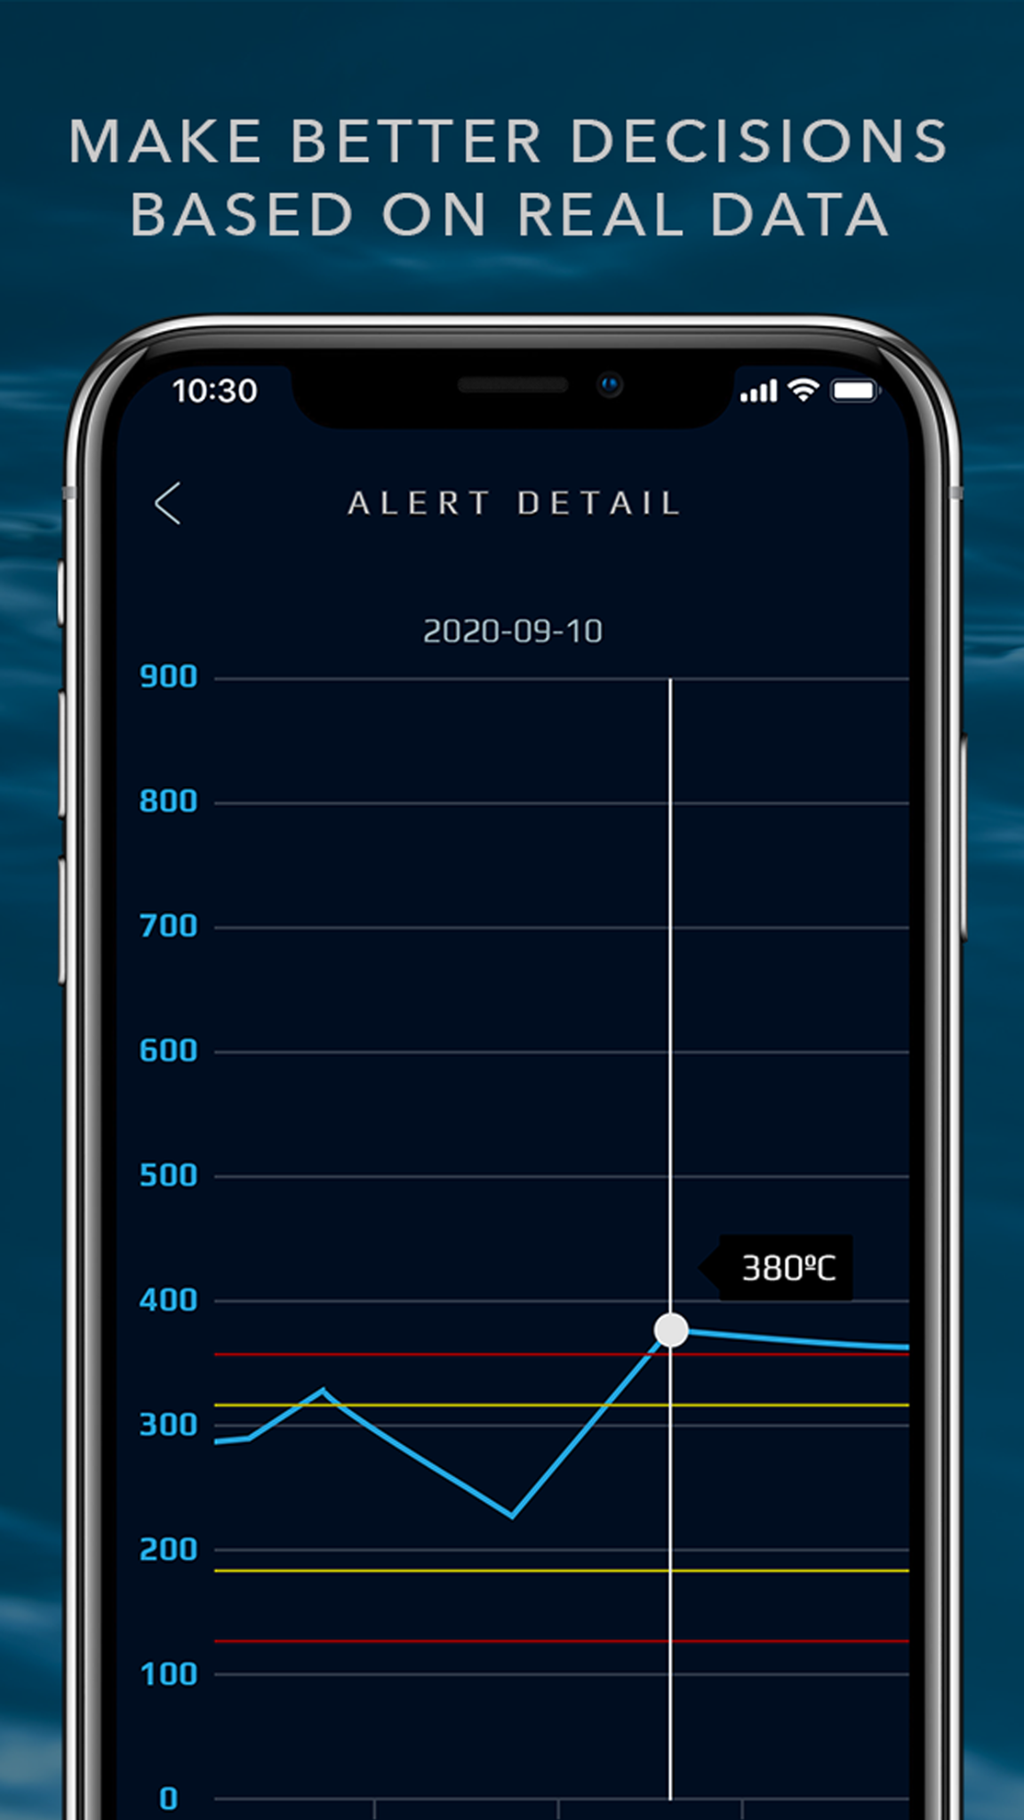
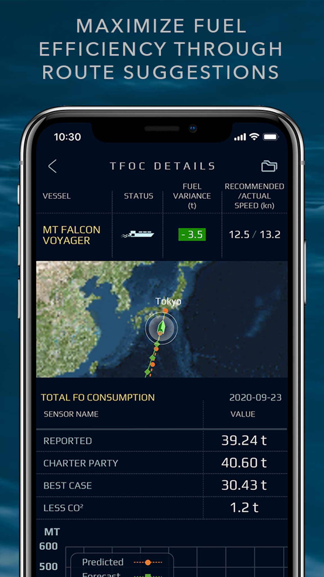
Mobile App Demo
Companion Mobile App to SMARTShip portal ‘Fleet In your pocket’ experience
Notes:
5

Slide 8
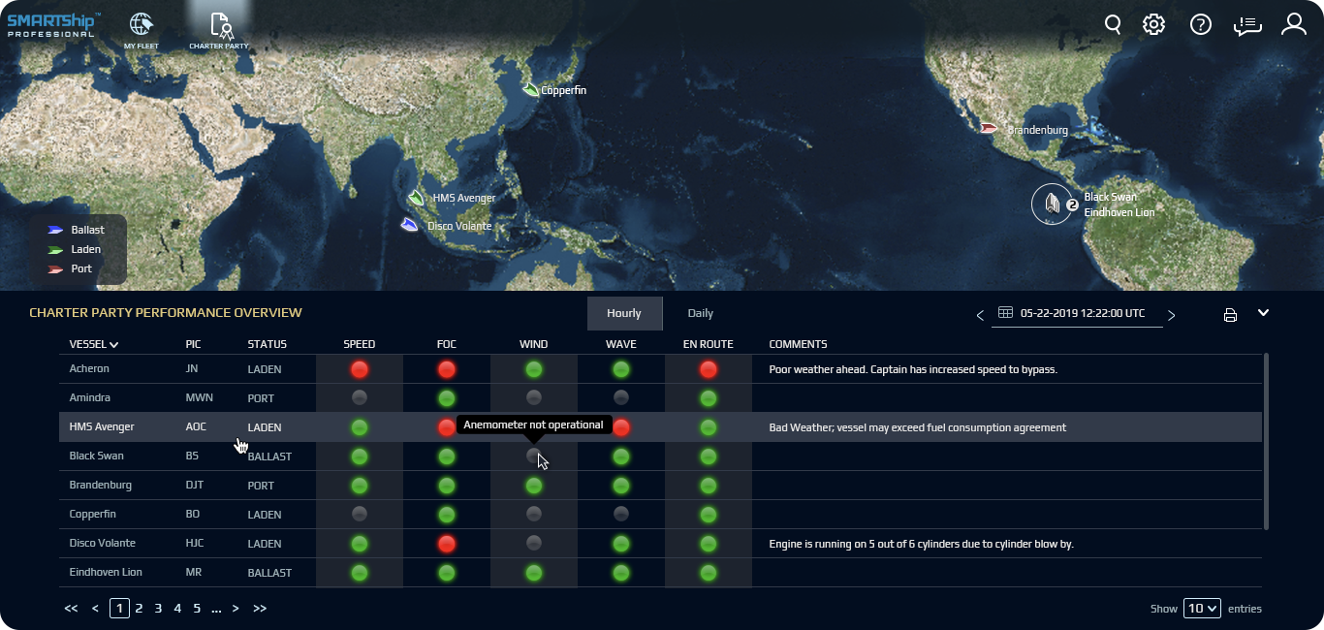
Charter Party (CP) Dashboard
CP Dashboard Demo
CP Dashboard provides a one click overview of performance against Charter Party parameters - speed, consumption, wave, wind, current and deviation from route.
Notes:
Key Features:
Quick overview of Commercial performance for all ships in fleet.
Traffic light system for summary information
Detailed drill down possible with a click.
Provide manual information related to a parameter

Slide 9
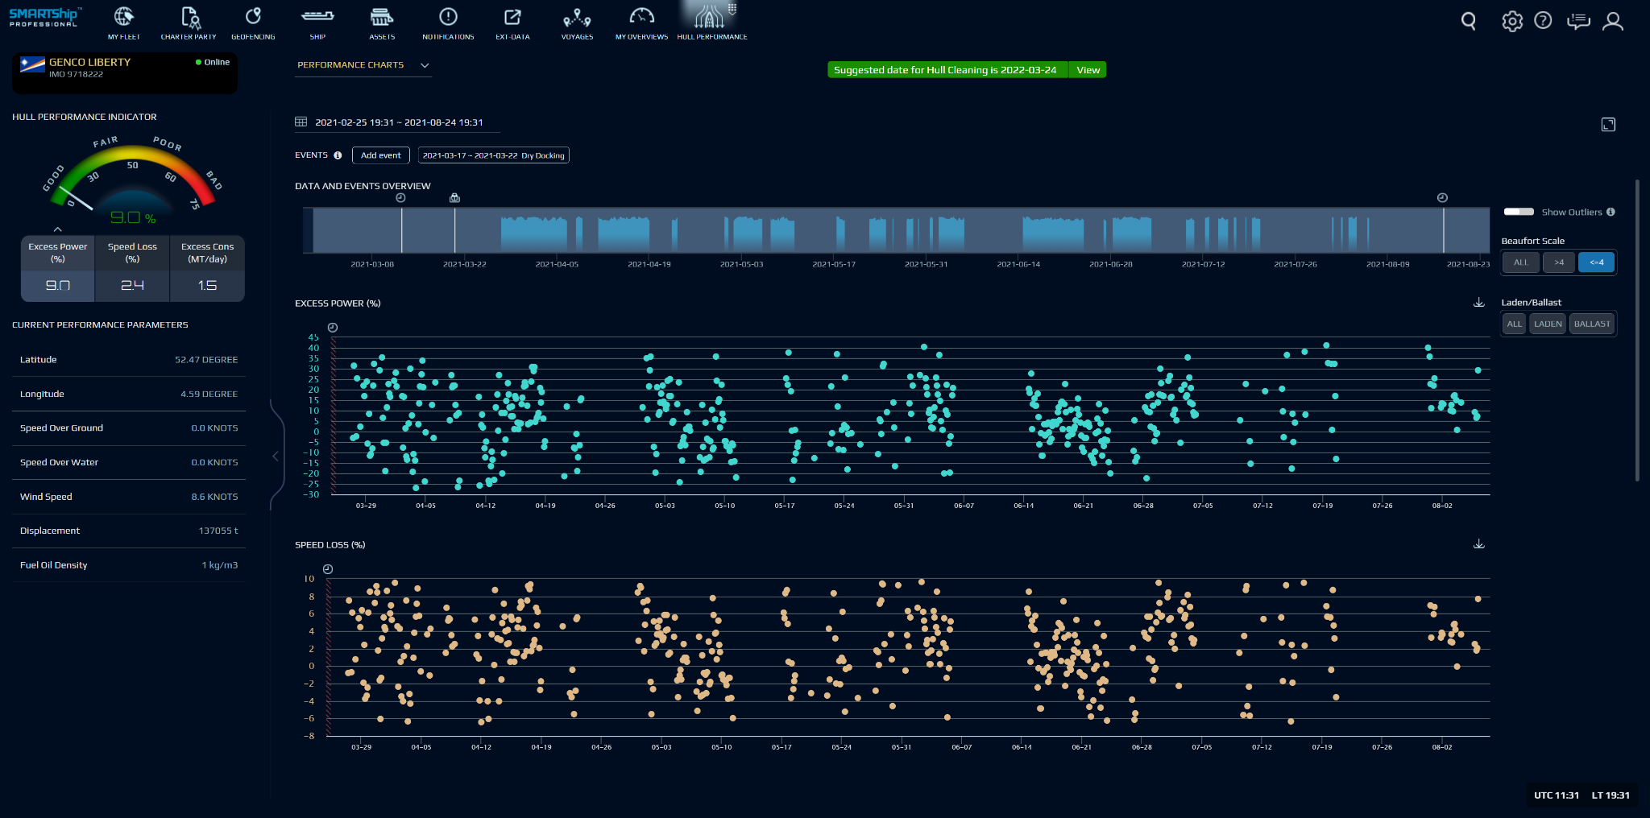
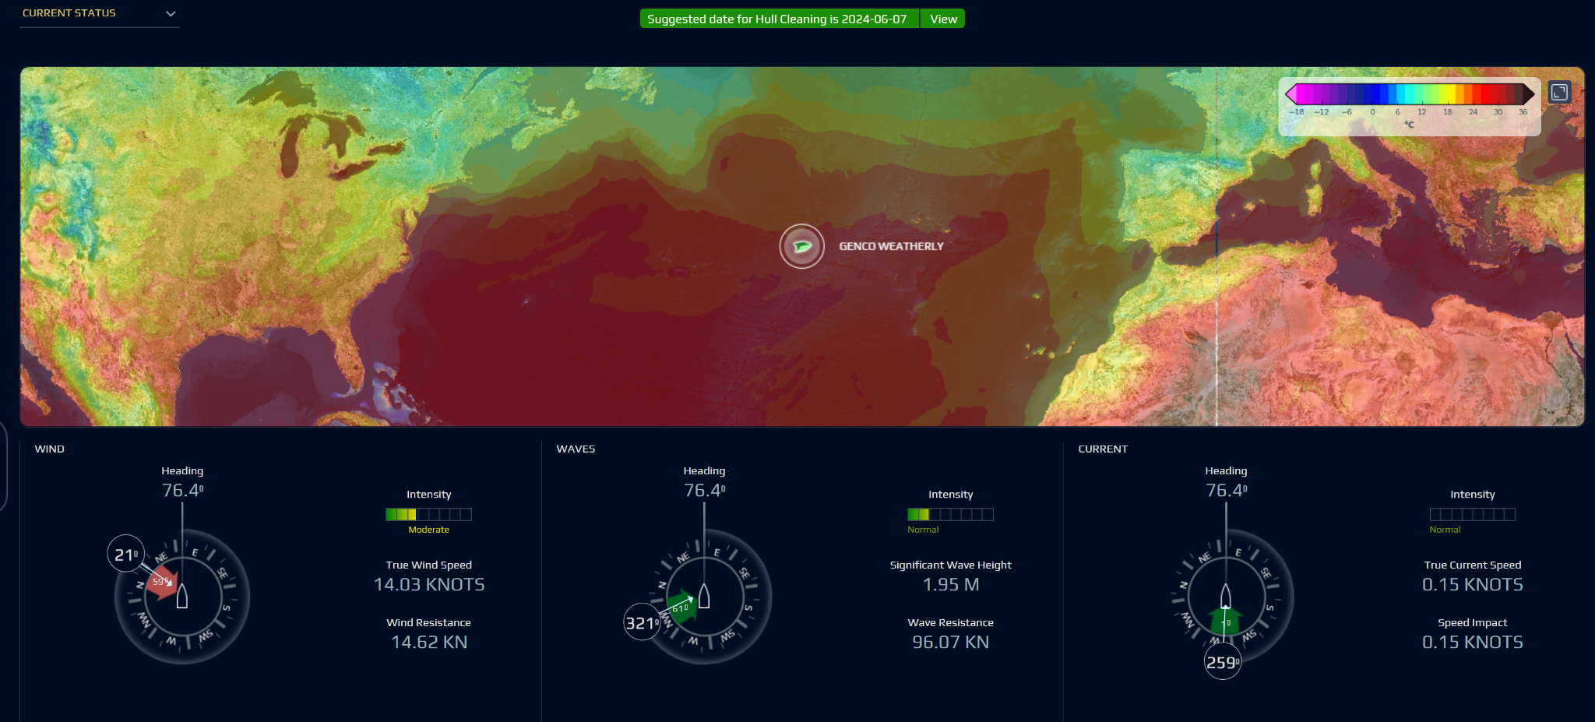
Automated Hull Performance Monitoring
Hull Performance Demo
Provides continuous monitoring of hull performance characteristics and a tool to check consumption at various speeds, dwt and hull condition
Notes:
Key Features:
Continuous monitoring of hull performance from delivery to docking
Impact of wave, wind and current
Impact of ocean zones
Baselining of hull performance in each loading condition.
Fuel Oil consumption calculator

Slide 10
3 Key REAL TIME Value Adds
A
Live Mobile App
Live CP Dashboard
Live Hull Performance
REAL TIME PERFORMANCE MONITORING
B
Fuel Optimization
Predictive Maintenance
REAL TIME PERFORMANCE ENHANCEMENT
C
Real Time Notifications and Advisory
Safety and Reliability
Compliance
REAL TIME ALERTS AND DECISION SUPPORT
Notes:
1

Slide 11
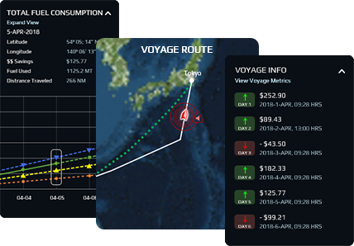
Fuel Saving Application: TFOC
Cost Savings
Total Fuel Oil Consumption (TFOC) :This big data based advanced analytics application optimizes total fuel oil consumption (TFOC) over a voyage through optimal ship heading and effective speed recommendation.
SHIP HEADING AND SPEED GUIDANCE
KEY VOYAGE METRICS INCLUDING REAL TIME $$ SAVINGS
BENCHMARKING AGAINST A GIVEN REFERENCE
Notes:
Key Features:
Optimal fuel oil consumption with heading and speed guidance
Key Voyage Metrics including real time $$ savings
Scenario based evaluations ex: fastest speed and best weather
Benchmarking against a given reference
Optimal fuel oil consumption with heading and speed guidance
Key Voyage Metrics including real time $$ savings
Scenario based evaluations ex: fastest speed and best weather
Benchmarking against a given reference

Slide 12
Process flow chart of fuel optimization using SMARTShip
Create Voyage Plan
Identify Benchmark Consumption
Execute advice for fuel optimization
Analyze Voyage to arrive at saving
Review Benchmark
Proprietary & Confidential
Notes:
Benchmark review examples
Initial baseline - basis long term
Important to identify and review the benchmark
Review periodically - such as in drydock
Favourable weather could have an impact
Sometime you would see there could be fluctuating values - because of bad weather days and benchmark identfied
Short voyages - because of small numbers, % value may look higher

Slide 13

TFOC: Fuel savings leading to sustainable shipping
44 Companies
44 companies ran 410+ confirmed successful voyages YTD.
Overall 2000+ TFOC voyages completed since inception.
9.1% Fuel Saving
Average fuel saving aggregated over all vessel types in above period.
Range varies from 5% to 13% depending on type of ships and their run.
36,026
CO2 Saving (MT)
Absolute savings achieved, basis confirmed successful voyages.
Arrived at by using the IMO multiplier for total 11,569 MTs of fuel saved.
$5.78 Million
Basis confirmed successful voyages. Target for 2021 is $10mn.
Arrived at basis an index based average price over the period ($500/ton)

Slide 14
TFOC Overview: 236,000 MT of Co2 saving with $5.78mn of realized fuel savings
COMPANY NAME | Ships @ TFOC | Successful Voyages | Fuel Saved (MT) | CO2 Saving (Tons) | $ Savings (USD)
Company 1 | 18 | 69 | 2,590.4 | 8066.5 | 1295200.0
Company 2 | 11 | 30 | 1,470.9 | 4580.3 | 735435.0
Company 3 | 4 | 12 | 939.9 | 2926.8 | 469950.0
Company 4 | 9 | 42 | 819.9 | 2553.0 | 409925.0
Company 5 | 19 | 29 | 724.3 | 2255.6 | 362173.1
Company 6 | 4 | 33 | 723.4 | 2252.5 | 361675.0
Company 7 | 3 | 16 | 657.4 | 2047.0 | 328680.0
Company 8 | 8 | 8 | 588.2 | 1831.7 | 294115.0
Company 9 | 21 | 7 | 580.1 | 1806.6 | 290070.0
Company 10 | 2 | 18 | 370.7 | 1154.2 | 185330.0
Company 11 | 6 | 14 | 355.6 | 1107.4 | 177810.0
Company 12 | 14 | 15 | 288.5 | 898.5 | 144265.0
Company 13 | 2 | 14 | 218.6 | 680.7 | 109290.0
Company 14 | 1 | 7 | 177.0 | 551.2 | 88500.0
Company 15 | 5 | 18 | 145.3 | 452.5 | 72655.0
Company 16 | 28 | 54 | 919.2 | 2862.3 | 459587.2
TOTAL | 168 | 414 | 11569.3 | 36026.8 | $ 5,784,650

Slide 15
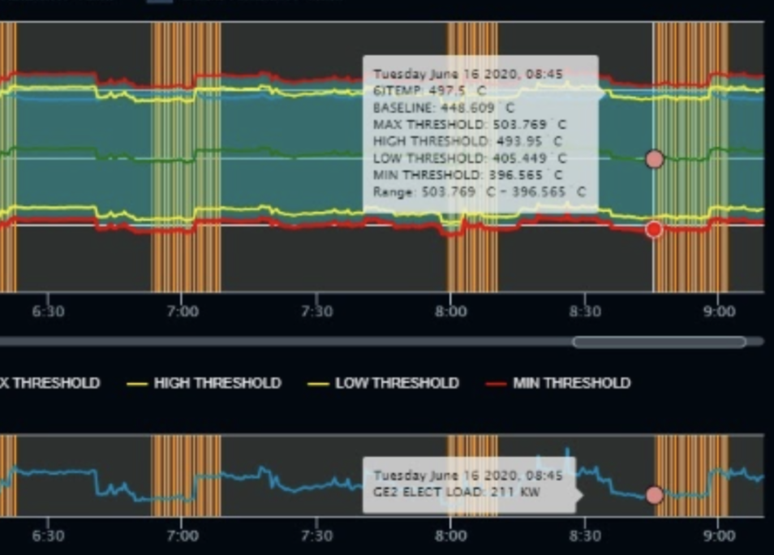
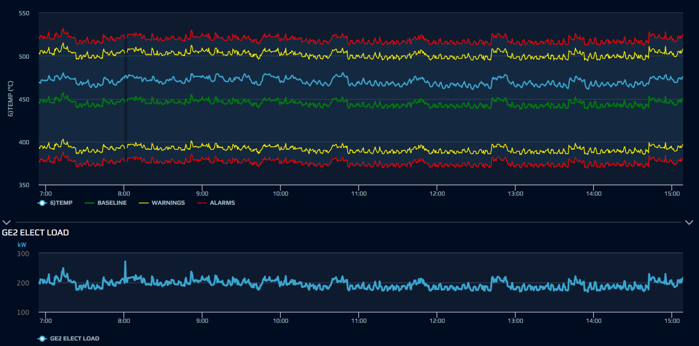

Case Study
Cost Avoidance: $ 8,000
PROBLEM
Generator Turbocharger Turbine side fouling
Normal Behavior
High Deviation in GE T/C In Temp Vs Power
“High Deviation Alert” triggered
RESULTS
The temperature deviation was higher as compared to baseline
T/C Overhaul planned
POTENTIAL CONSEQUENCES AND IMPACT
Turbocharger surging
Potential Turbocharger breakdown
Notes:
Cost Avoidance : $ 8,000
The temperature deviation was higher (approx. 50°C) as compared to normal threshold (<30°C)

Slide 16
3 Key REAL TIME Value Adds
A
Live Mobile App
Live CP Dashboard
Live Hull Performance
REAL TIME PERFORMANCE MONITORING
B
Fuel Optimization
Predictive Maintenance
REAL TIME PERFORMANCE ENHANCEMENT
C
Real Time Notifications and Advisory
Safety and Reliability
Compliance
REAL TIME ALERTS AND DECISION SUPPORT
Notes:
1

Slide 17
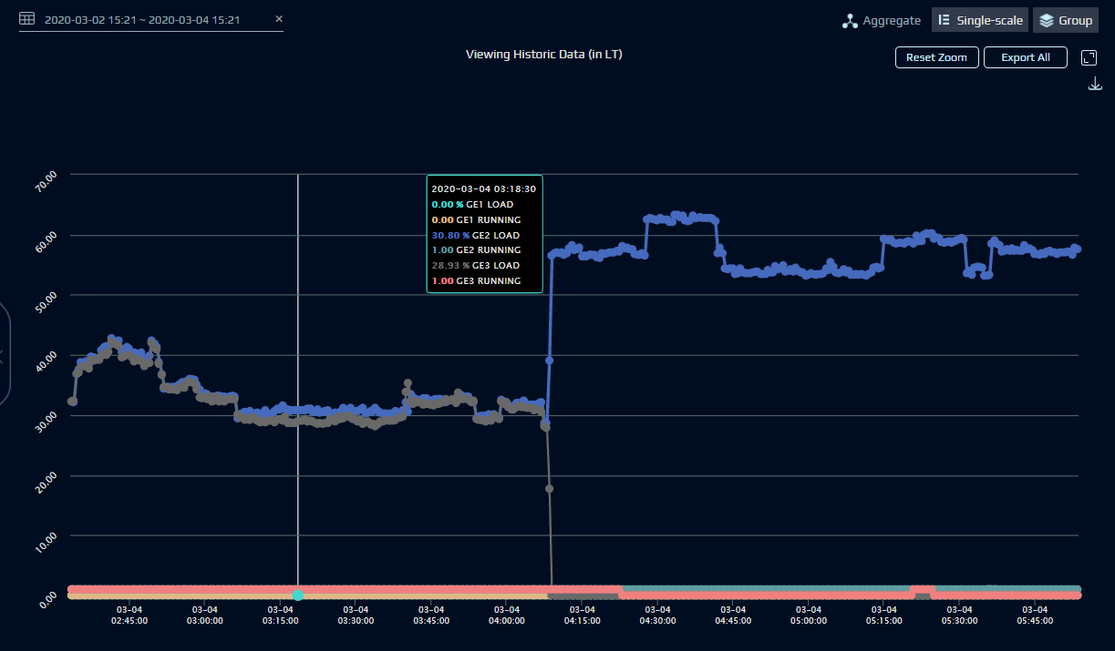
Case Study
Cost Avoidance: $ 7,000
Enhance operational energy efficiency
PROBLEM
Redundant GE Running (at low Load)
Two GE Running at Low Load
Two GE Running at Low Load
RESULTS
Vessel running two GE's at lower load (<40%)
Vessel was advised and updated the operating procedures
POTENTIAL CONSEQUENCES AND IMPACT
Lead to operation and energy Inefficiency
High generator running hours, fuel consumption and CO2 emission

Slide 18
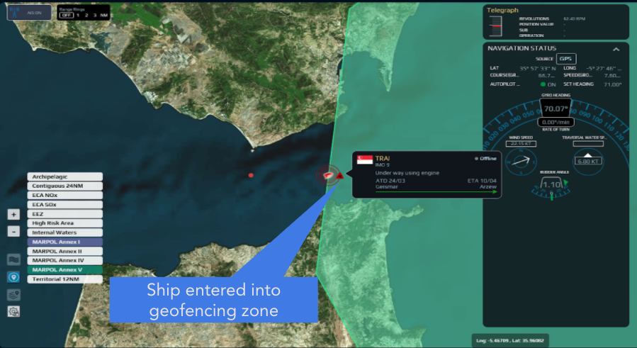
Case Study
Improve Safety and Regulatory Compliance
PROBLEM
Lack of real time monitoring and alerts for geofencing areas
Ship entered geofenced zone(s) - (Marpol Annex V and Marpol Annex I) activated
RESULTS
SMART Notification raised stating vessel entered into MARPOL ANNEX V and MARPOL ANNEX I area.
Vessel was advised to follow local and international regulations
POTENTIAL CONSEQUENCES AND IMPACT
Ship Staff were alerted to remain vigilant and adhere to any applicable regulation.

Slide 19
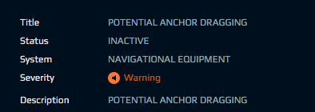

Case Study
Lead Safer Navigation
PROBLEM
Potential Anchor Dragging
SMARTNotification “Potential Anchor Dragging” activated.
RESULTS
The vessel was at anchor and swinging continuously leading to vessel going out of swinging circle
Vessel was alerted immediately by shore staff
Anchor was heaved up and re-anchored as a precautionary measure.
POTENTIAL CONSEQUENCES AND IMPACT
High chances of Anchor getting dragged.
Chances of collision and grounding.
Distance travelled calculation on a real time basis
Swinging Circle

Slide 20
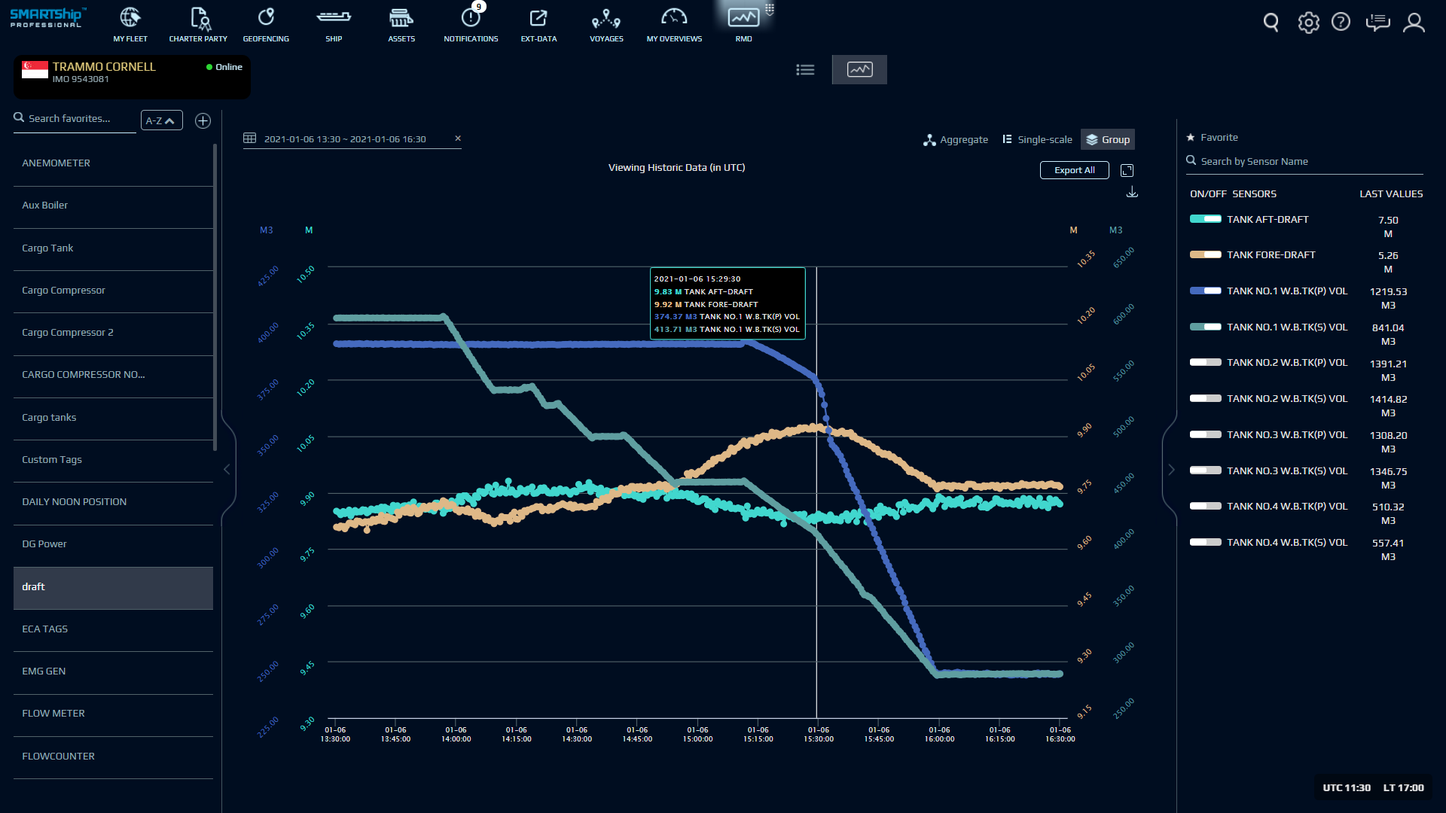
Case Study
Lead Safer Navigation
PROBLEM
Vessel Trimmed Down By Head
SMARTNotification "Vessel Trimmed Down By Head" triggered
RESULTS
Vessel was identified as down by head post bunkering.
Vessel was advised to correct the ballast so as to maintain trim by astern while sailing.
POTENTIAL CONSEQUENCES AND IMPACT
Increased fuel consumption and reduced speed
Poor engine performance
Delays in vessel arrival and potential off-hire
Vessel Trimmed Down By Head

Slide 21
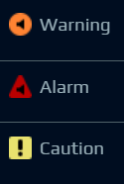
Sample of 75+ key alerts & notifications available in SMARTShip
S.NO | PRIORITY | NOTIFICATION NAME | DESCRIPTION
1 |  | Ship Consumption found to be outside the Charter Party tolerance limit | Vessel's average fuel consumption is outside the charter party limit given in the voyage plan
2 |  | Ship Speed found to be outside the Charter Party tolerance limit | Vessel's average speed is outside the charter party limit given in the voyage plan
3 |  | Voyage route deviation found to be outside the Charter Party tolerance limit | Voyage route deviation is outside the charter party limit given in the voyage plan
4 |  | Extra GE running at sea | Vessel running extra Diesel Generator with low load at sea
5 |  | Asset AI: Component Health Low | Based on machine learning from data, Asset AI has detected a significant deterioration of component health
6 |  | Hull Performance is in poor condition (Speed Loss) | Speed Loss against the benchmark is in poor condition
7 |  | Vessel observed to be in idle condition | Ship is observed to be in idle condition
8 |  | Ship under <100 NM from ECA Zone | Ship is within 100 NM of ECA zone by distance. Confirm if ship is going to ECA area and ensure FO change over preparation is in progress. Adhere to ECA regulation and any applicable local regulation
Notes:
See the detrimental effect of vessel current speed on next year CII ratings.
CP speed /consumption is very manual driven: We could use this platform to get better, faster and help chartering team to plan it further
Predicting: using previous vessels voyage data: provide range of options to charterer to negotiate the terms.: Consumption/ ...speed. Discussion.
Use consumption and speed profile.. Create a mechanism to use speed consumption curve.
Optimizing speed consumption for bunker price environment (its not yet there)
Create dashboard with data set for speed consumption table
Timing of all installation

Slide 22

Thank You - Alpha Ori Team!

